Slide 1


Evidence for high temperature, moderate pressure shock transformation in L chondrites
Acfer 040 and RC 106
Riley Trickey
Mentor: Professor Thomas Sharp
School of Earth and Space Exploration
Arizona State University

Slide 2
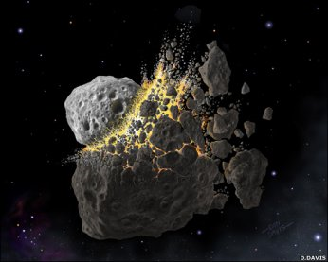
Chondrites
Most common type of meteorite
Remnants of planetary formation
Many have been “shocked” by high T & P
Shocked Chondrites
Result of impacts between asteroids
Record shock conditions, thereby serving as a means to reconstruct shock/impact history

Slide 3
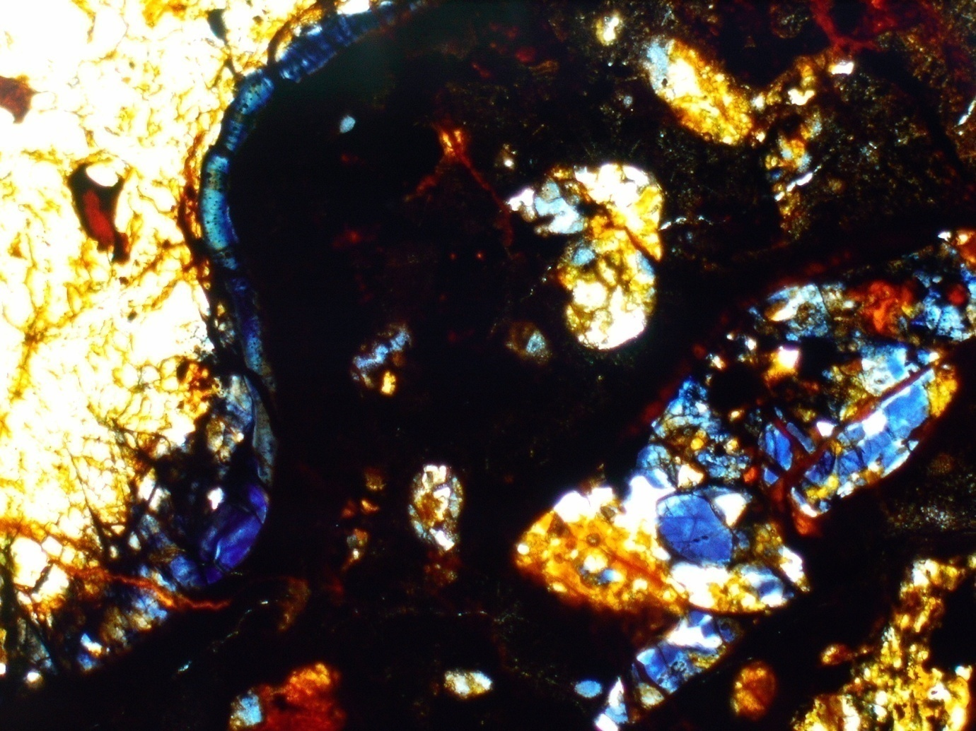
Formation and significance of melt veins
Chondrites that are shocked to the greatest degree (S4-S6) contain regions that became molten during the shock event, forming melt
veins/pockets.
Minerals within and adjacent to melt veins or pockets may be partially or fully transformed into high-pressure phases.

Slide 4
Problem (controversy): calibrating shock pressures to observations from chondrites
Stöffler et al., 1991
Transformations occur as a result of localized extreme pressures (S6: 50-95 GPa)
Transformed areas = areas where pressure was the greatest
Sharp, Chen, El Goresy, Xie, and others
Transformations occur at extremely high temperature and moderate pressure (S6: ~25 GPa)
Transformed areas = areas that became the hottest
  Melt veins are analogous to dike intrusion
  Transformation is contact metamorphism

Slide 5
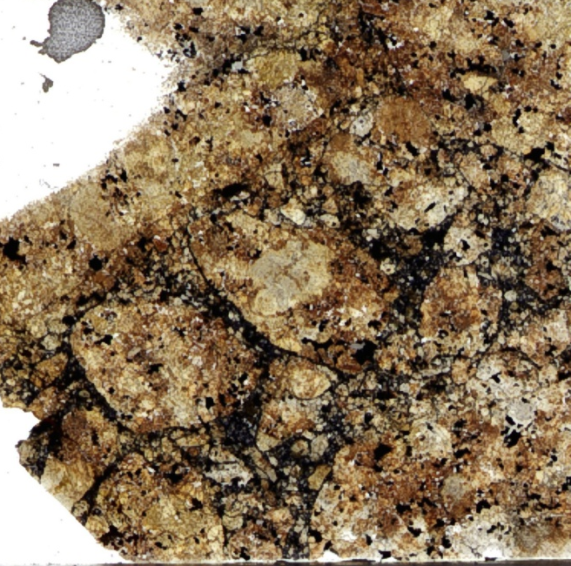
Objective:
To test the contact-metamorphism hypothesis (high T, mod. P) for shock transformation on L6 chondrite Acfer 040.
Methods:
Use of optical microscopy, electron microscopy, and Raman spectroscopy to characterize the melt vein mineralogy, microtextures, and spatial distribution of transformed high-pressure minerals.

Slide 6
Melt vein mineralogy in Acfer 040:

Slide 7
Melt vein mineralogy in Acfer 040:

Slide 8
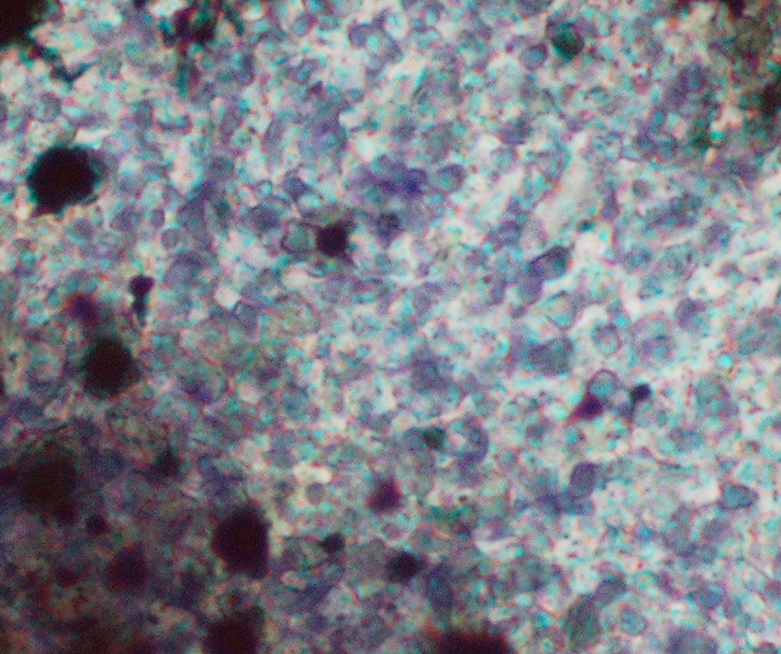
Melt vein mineralogy in Acfer 040:

Slide 9
Melt vein mineralogy in Acfer 040:

Slide 10
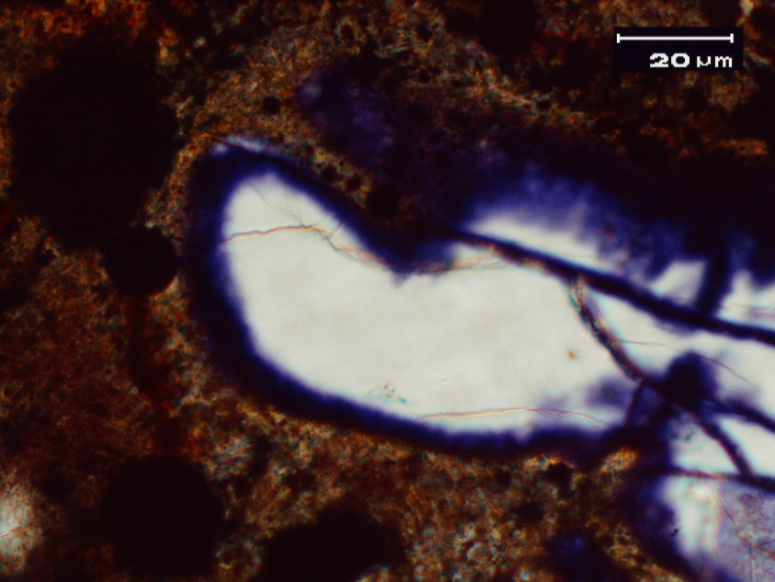
Melt vein mineralogy in Acfer 040:

Slide 11
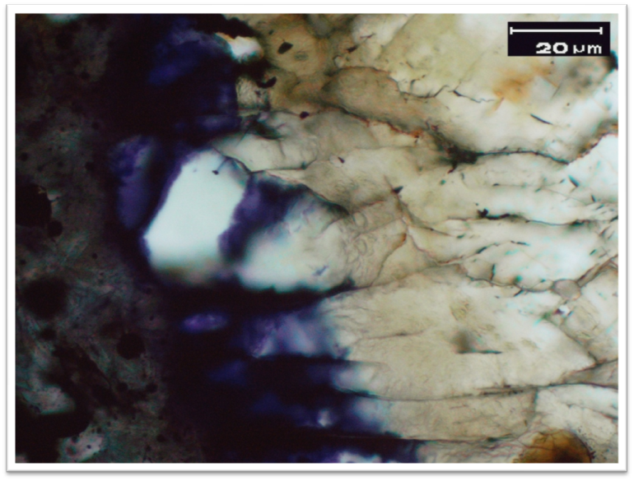
Melt vein mineralogy in Acfer 040:

Slide 12
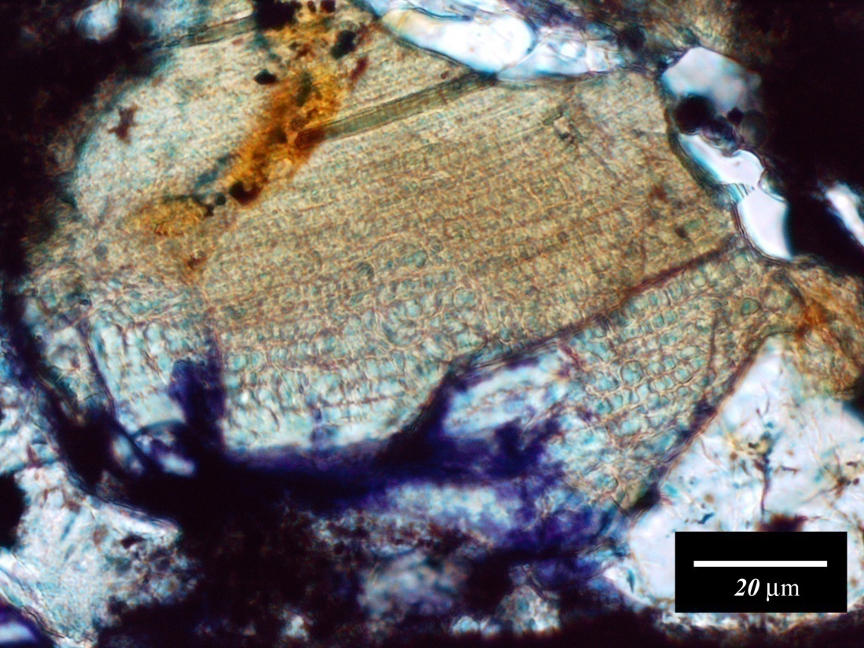
Partially transformed olivine-ringwoodite:
Partially-transformed olivine-ringwoodite grains are generally transformed in a distinctly linear manner, allowing a “ringwoodite vector” to be assigned for each partially-transformed grain.
Olivine
Colorless
ringwoodite
Blue ringwoodite

Slide 13
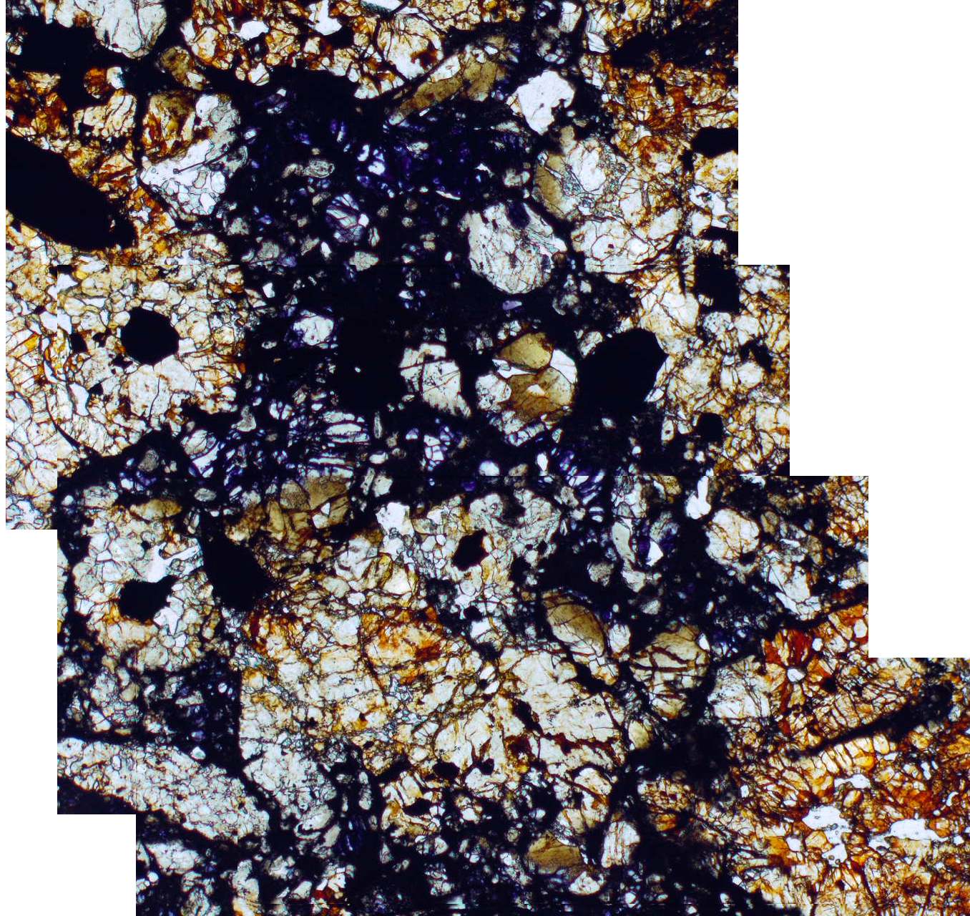
Spatial distribution of ringwoodite and partially transformed grains:

Slide 14
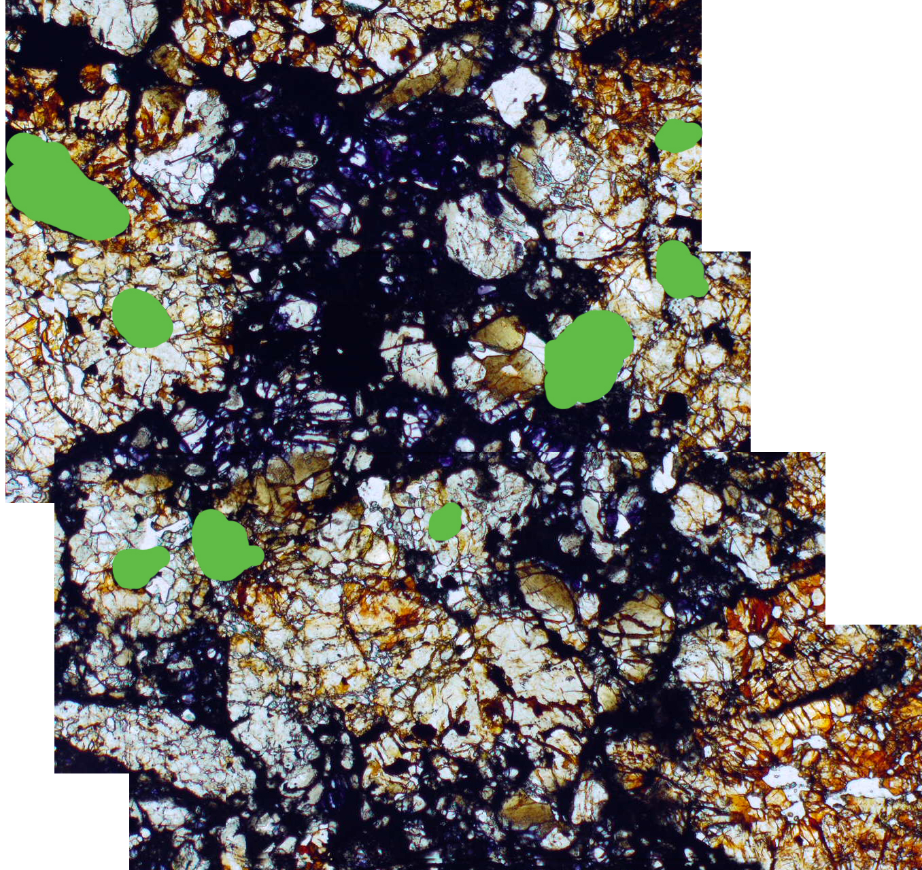
Spatial distribution of ringwoodite and partially transformed grains:
Metal-sulfide

Slide 15
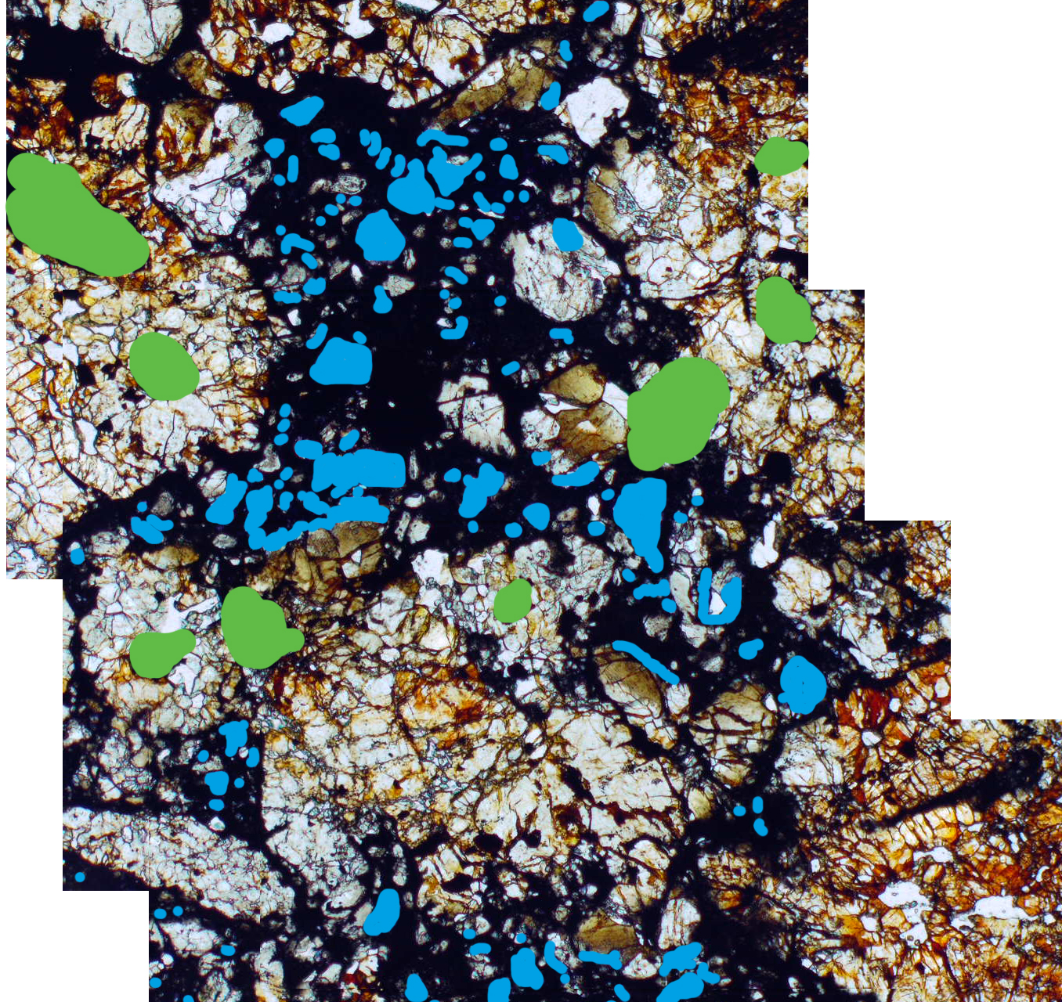
Spatial distribution of ringwoodite and partially transformed grains:
Metal-sulfide
Ringwoodite

Slide 16
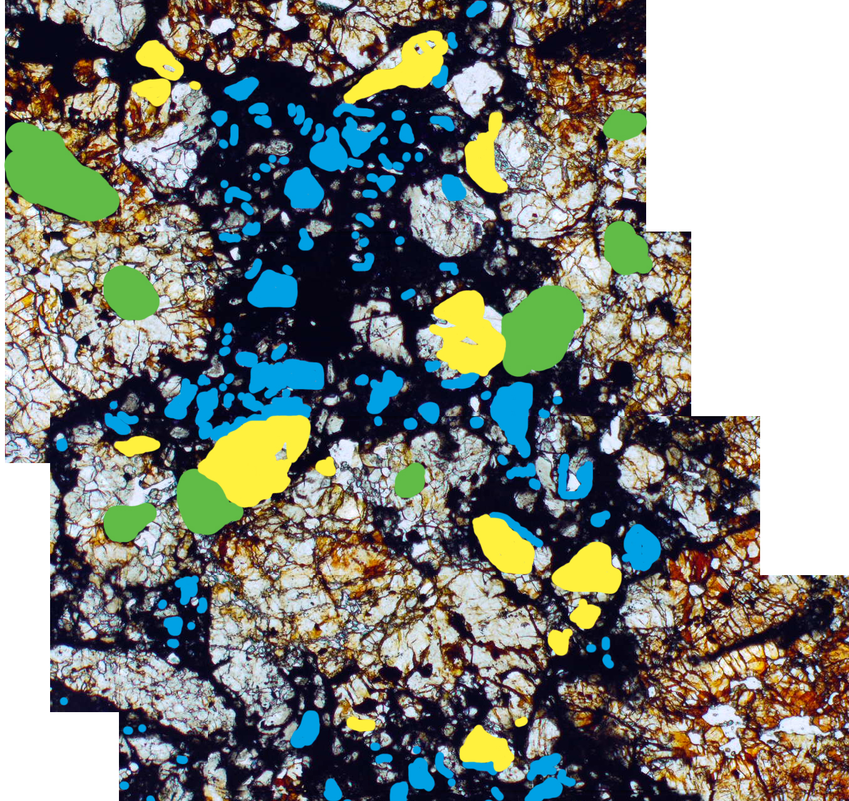
Spatial distribution of ringwoodite and partially transformed grains:
Metal-sulfide
Ringwoodite
Partially-transformed

Slide 17

Spatial distribution of ringwoodite and partially transformed grains:
Metal-sulfide
Ringwoodite
Partially-transformed
Ringwoodite vector

Slide 18
Conclusions:
Observations from RC 106 and Acfer 040 are consistent with what is predicted by the contact-metamorphism hypothesis (high T, mod. P) for shock transformation.
The “ringwoodite vector” for partially-transformed olivine-ringwoodite grains can serve as an effective means of identifying regions of a melt vein that experienced the highest temperature.
Variable extent of transformation among adjacent and nearby grains of similar size indicates that melt vein temperatures are less homogeneous than previously believed.
Complex transformation microstructures suggest that local deformation also plays an important role in the olivine-ringwoodite transformation.

Slide 19
Thank you

